Slide 1
Ecommerce Shipping

Slide 2
About Us
Ecommerce · Branding · Web Development

Slide 3
What you’ll learn
Is shipping realistic?
Fulfillment methods
Marketing tactics
Evaluating costs
Where to go for answers
Resources
Q & A

Slide 4
Definitions
Fulfillment
The entire act of receiving, processing and delivering orders to end users
Shipping
The act of transporting products to end users

Slide 5
The Ecommerce Shipping Canvas
Let’s start recording your strategy and building better communication
You can find and download the canvas for free here:
Sprintpoint.ca/products/ecommerce-shipping-canvas

Slide 6
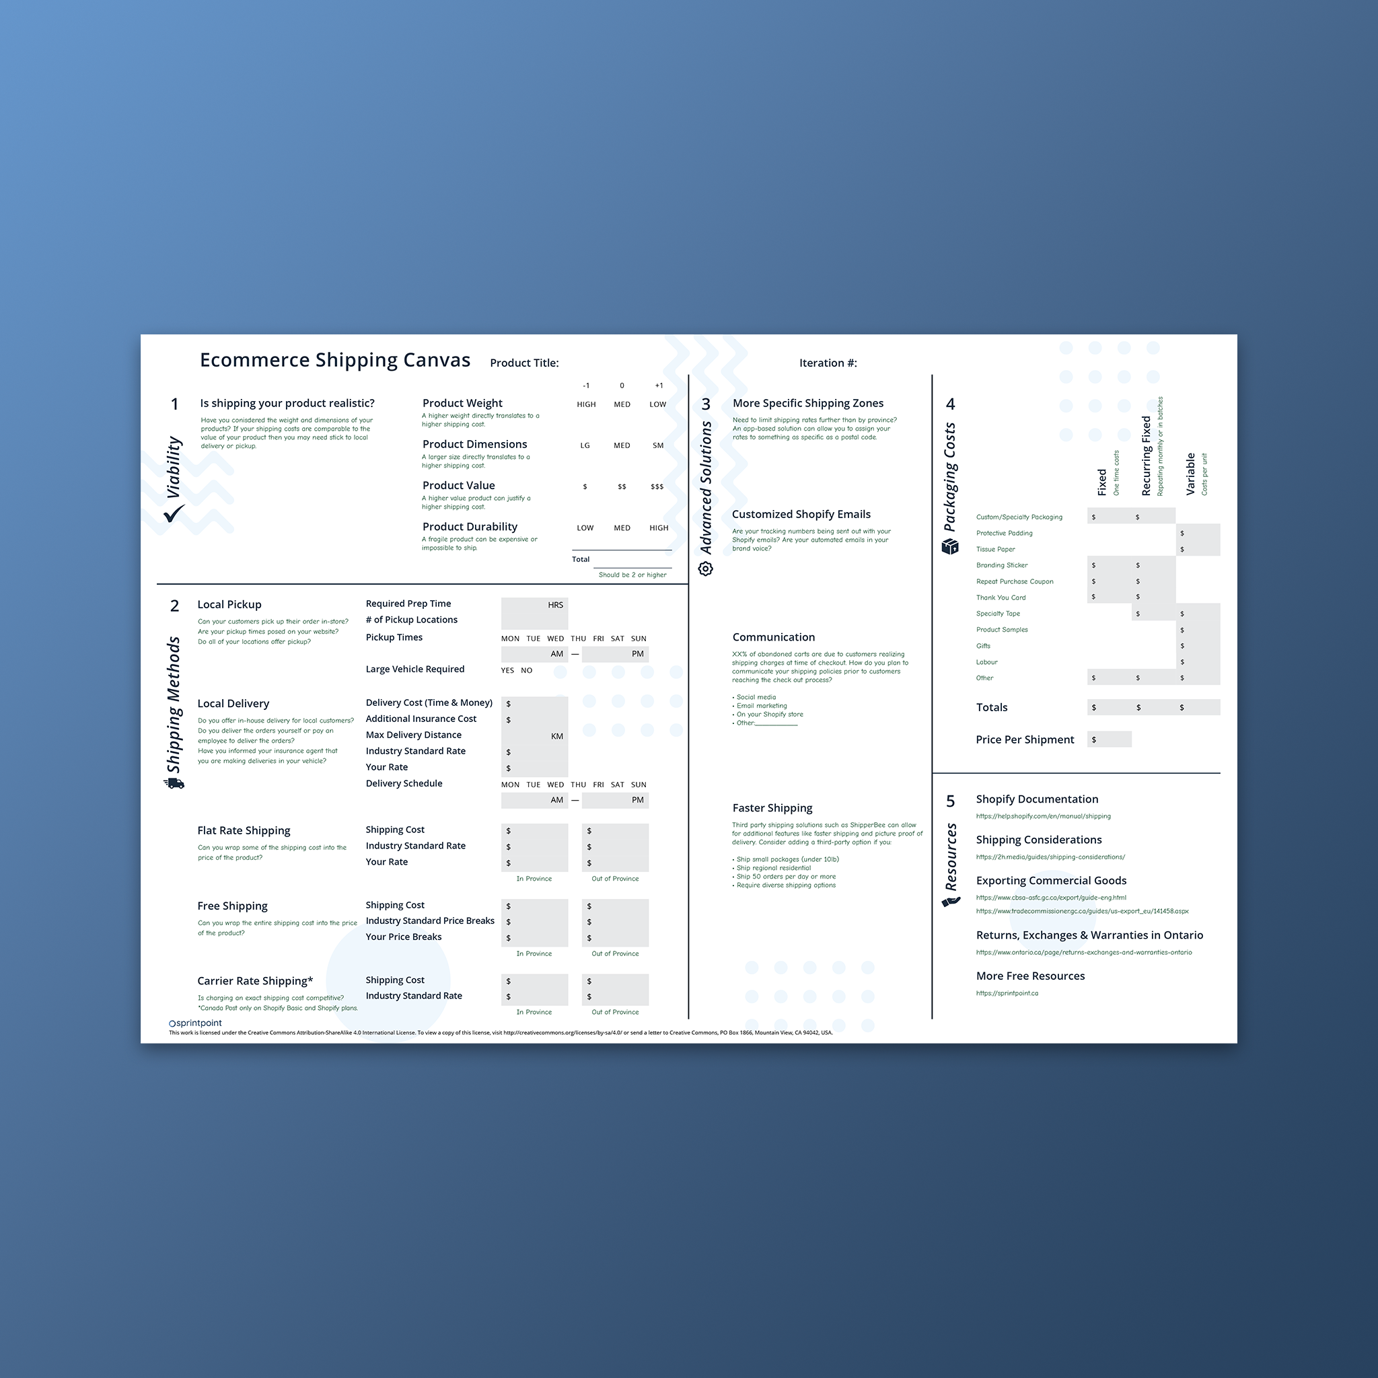
Why use a canvas?
You can’t measure what you don’t track
Easily isolate strengths and weaknesses
Better business transparency
Creates clear communication
After you complete the canvas once iterations can be made very quickly

Slide 7
Determining Viability

Slide 8
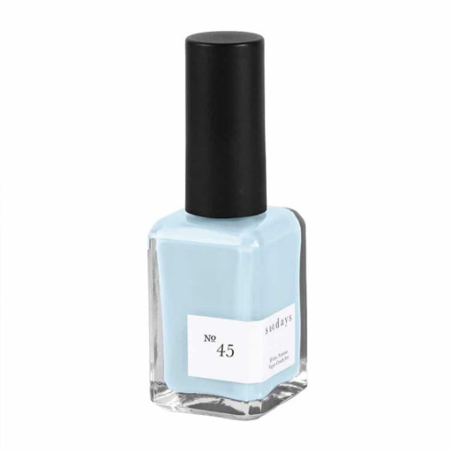
Starting with the best-case scenario
The most ideal products are lightweight, have small shipping dimensions, have great margins and aren’t fragile.

Slide 9
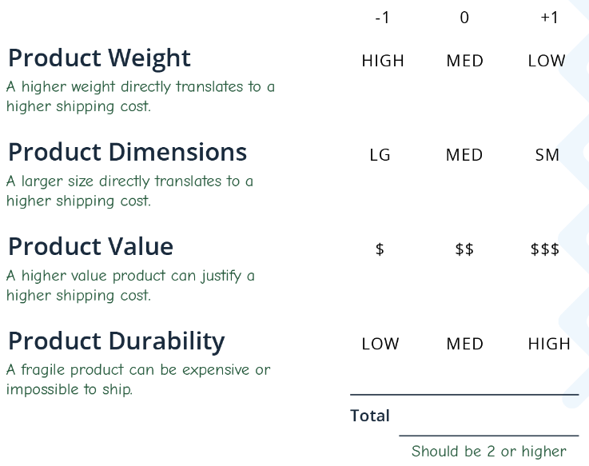
Rate your products
Based on your scores some shipping methods will be more viable than others.
Products with a score lower than 2 will be more difficult to scale or ship nation wide.
If you can’t ship Canada wide affordably it is advised to focus on your local audience and local competition.

Slide 10
Focus on your strengths
With a product score greater than 2
Use targeted advertising to attract new customers
Focus on developing markets outside of your local community
Referral marketing and building brand loyalty is extremely important
Try to appear bigger than you actually are. You have more competition.

Slide 11
Focus on your strengths
With a product score less than 2
Refine your delivery area
Highlight local delivery or curbside pickup
Focus on your community involvement
Build brand ambassadors in your local area
Your communication strategy should focus on your local advantage

Slide 12
Shipping Methods

Slide 13
Common shipping methods
Not every business needs every method. Focus on what is most aligned with your brand and what your customers require.
Local pickup (curbside, etc.)
Local delivery
Flat rate shipping
3PL (custom)

Slide 14
Shipping strategies
The most popular shipping strategies
Offer free shipping
Charge exact costs
Provide flat-rate shipping
Provide local delivery
What are you competitors doing? What is the industry standard? What do your customers expect?

Slide 15
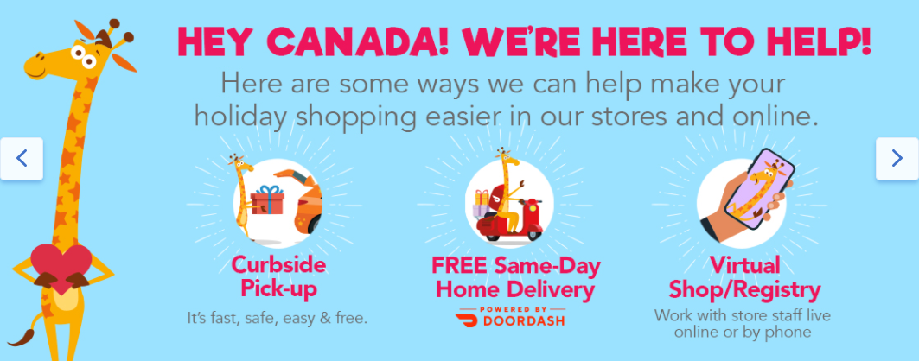
Communicating your shipping strategy
Your shipping strategy should meet all the following requirements:
Be clear (don’t use jargon)
Be visible (position it in more than one place)
Act as a CTA (call-to-action), the strategy should help you sell
Have limited conditions

Slide 16
Understand your margins
Complete section 2 of the canvas and ensure you have factored in every possible shipping expense.
Many businesses underestimate the costs of sending products to customers.
Remember, you should be able to beat a brick and mortar selling the same products since you don’t have the added expenses they have.

Slide 17
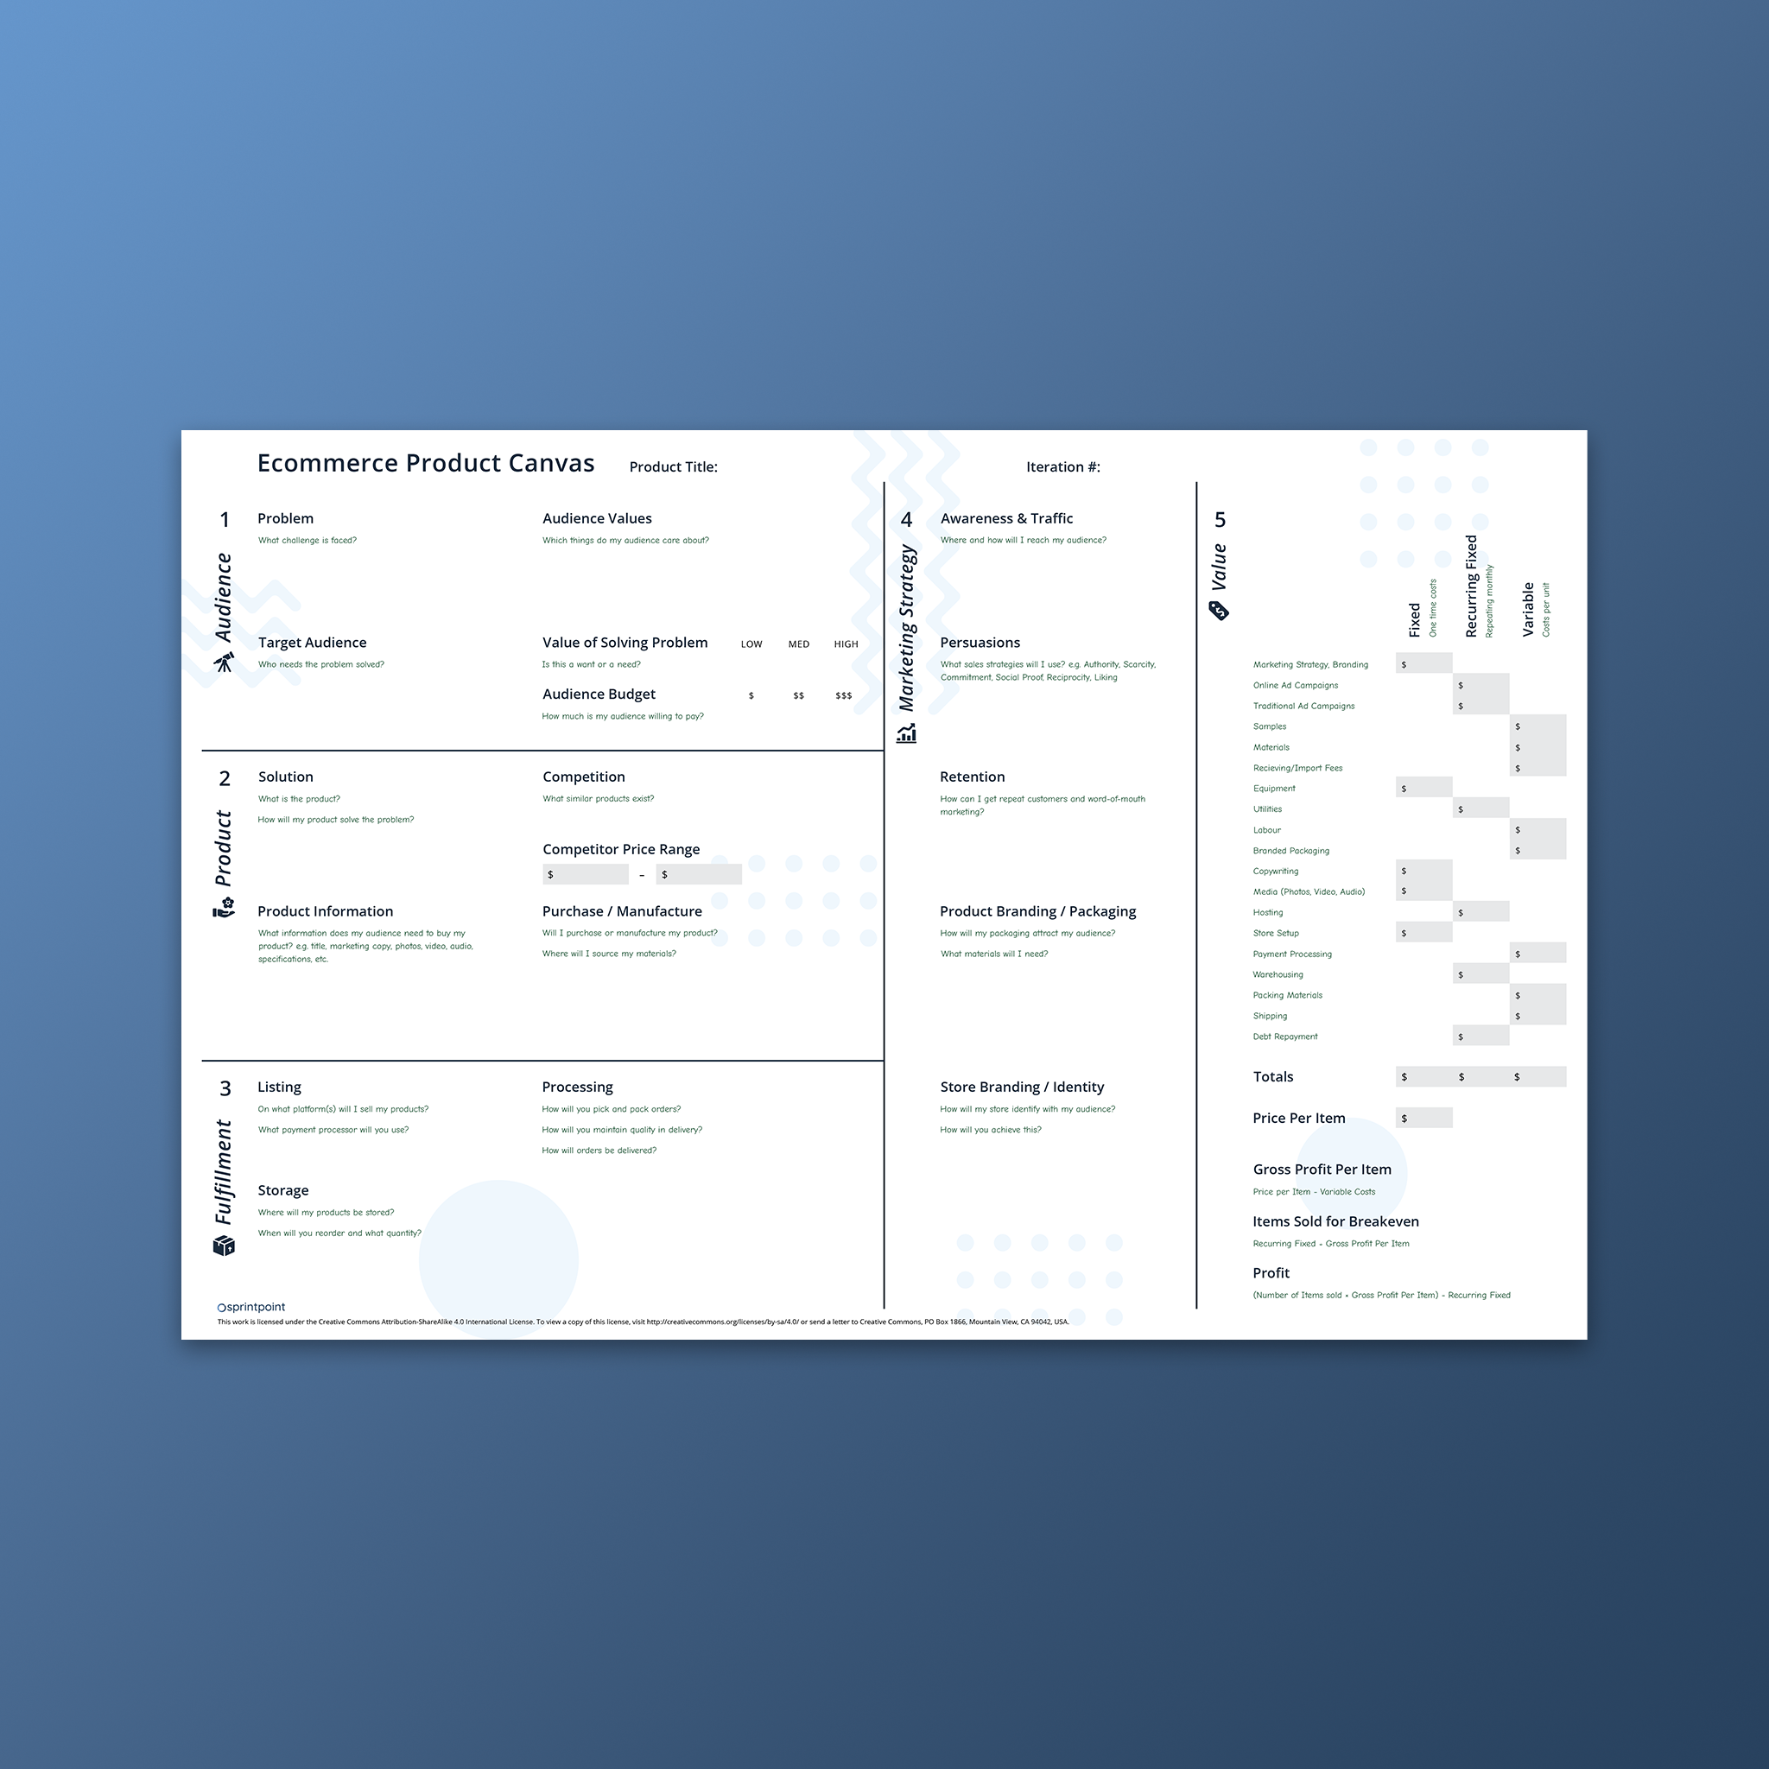
Make sure you understand your costs
You can complete the Product Canvas to fully refine your costs. Sprintpoint.ca/products/ecommerce-product-canvas

Slide 18
Advanced Solutions

Slide 19
Refine your shipping zones
Shopify handles province by province zones for flat rate shipping.
We recommend Better Shipping for flat-rate shipping with area code targeting.
If dimensional weight is required, we recommend Intuitive Shipping.
Dimensional Weight: If you have multiple shipping packaging options with different dimensions, you need Dimensional Weight to calculate carrier rates.

Slide 20
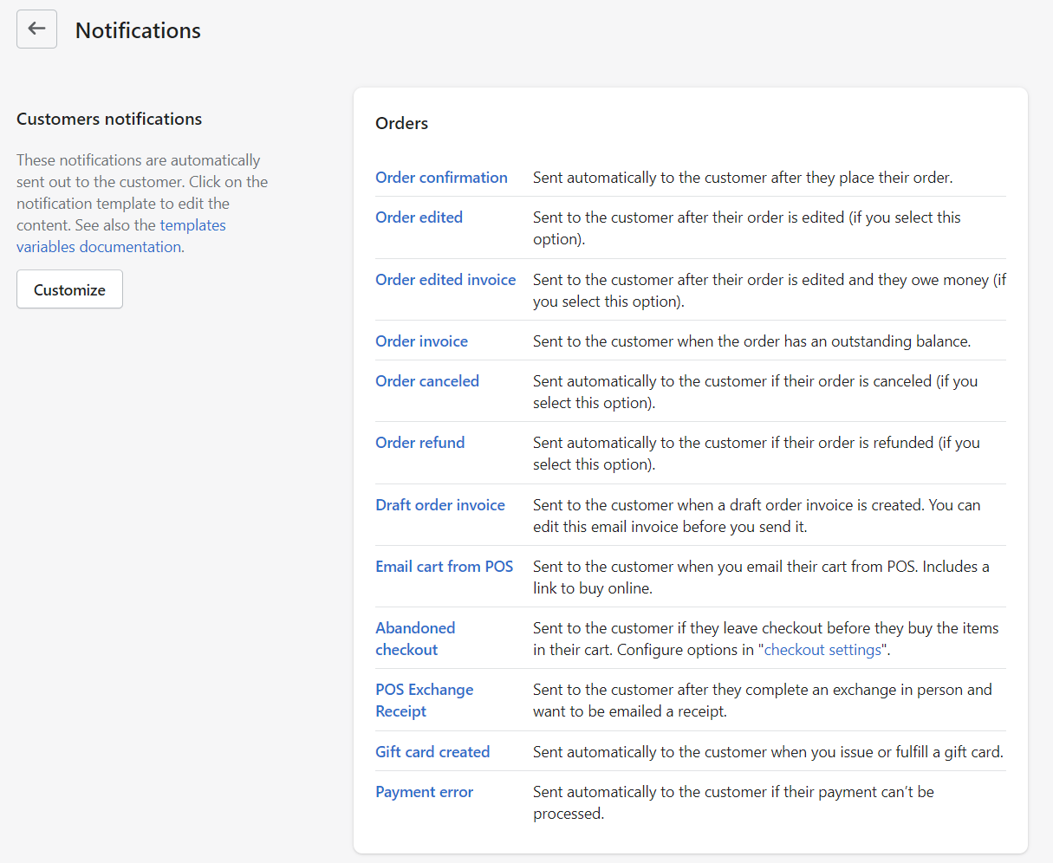
Additional communication
Every touchpoint post purchase should be on brand.
You can customize the automated emails from your Shopify dashboard Settings>Notifications.
You can customize a variety of emails from Orders to Shipping, Local delivery, Local pickup, Customer, and more.

Slide 21
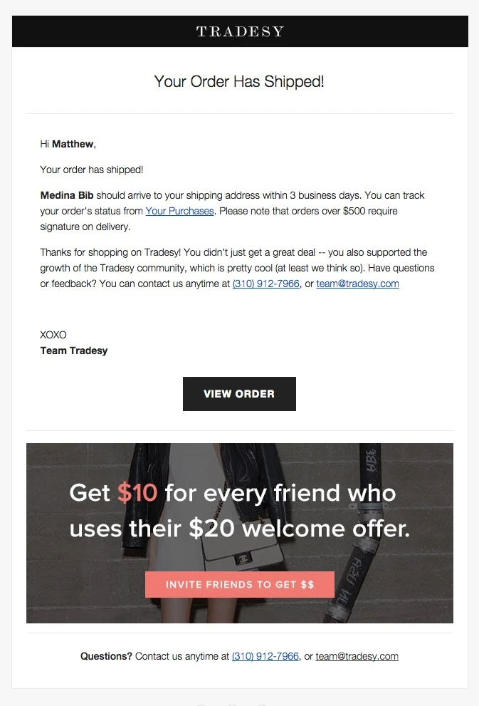
More touchpoints
Post-purchase emails
Do you reach out for a product review?
Do you offer great customers a discount?
How are your managing abandoned carts?
Are you utilizing discount codes as a promotional tool?
Do you offer any non-sales related information to customers post purchase?

Slide 22
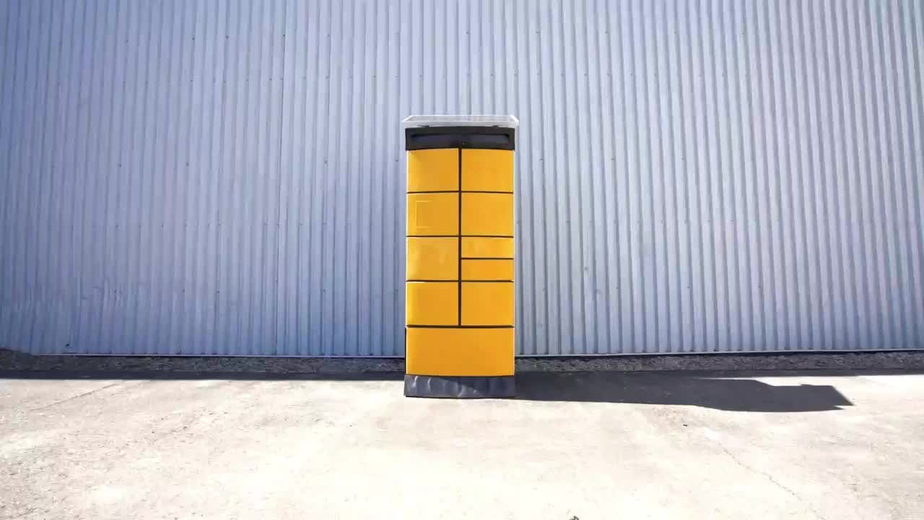
Faster shipping lower carbon footprint
Offering an eco-friendly option is a great competitive advantage for some brands.
Explore your regions shipping options. When was that last you sought out a new shipping provider?
Find more information about ShipperBee here: https://www.shipperbee.com/

Slide 23
Packaging Costs

Slide 24
Packaging
Based on your margins, your brand and your industry standards the product and shipping packaging your customers can expect will vary.
Conduct competitor research, do you know what your competition is doing? A quick Google search should be able to give you more information about how your competition is approaching packaging. If you can’t find information, and you aren’t sure of your approach, buy from a competitor.

Slide 25
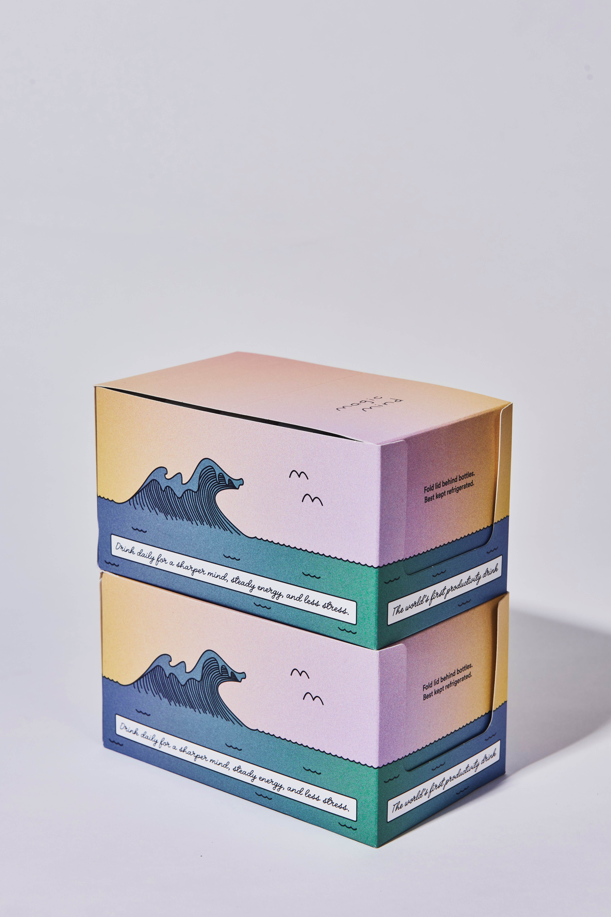
Packaging needs to match your brand
Packaging plays a huge role in how customers feel about your brand. If your materials aren’t inline with how your brand presents itself, it creates a disconnect before the customer even interacts with your products.
If your brand is trying to appear as a luxury option, your packaging needs to feel premium. This is a major factor when trying to attract repeat customers.

Slide 26
Tools to match your strengths
With a product score greater than 2
Include a discount coupon to encourage repeat business
Adding a small gift or a sample will help create excitement and brand loyalty
Reminding customers to leave a review is extremely important
Highlight your social media for new product launches or availability
Your products are better suited for influencer marketing

Slide 27
Focus on your strengths
With a product score less than 2
Include a thank you note for curbside pickups
Encourage others to shop local
Highlight the ability to sell gift cards
Including a smaller sample of your product and encourage customers to share with a friend
Keep your customers up-to-date with your community involvement

Slide 28
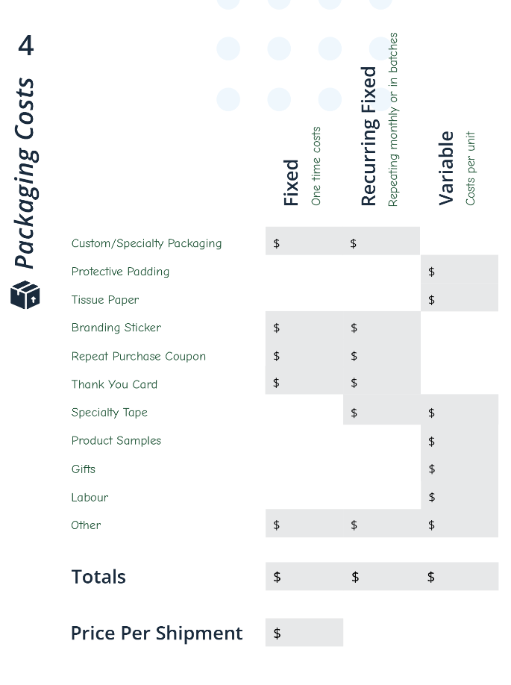
Understanding your costs
Complete section 4.
As your business grows you will spend more and more on packaging, however the price per unit needs to go down. You should be able to realize discounts from ordering your packaging material in bulk.
Your packaging should always be getting better for less money.

Slide 29
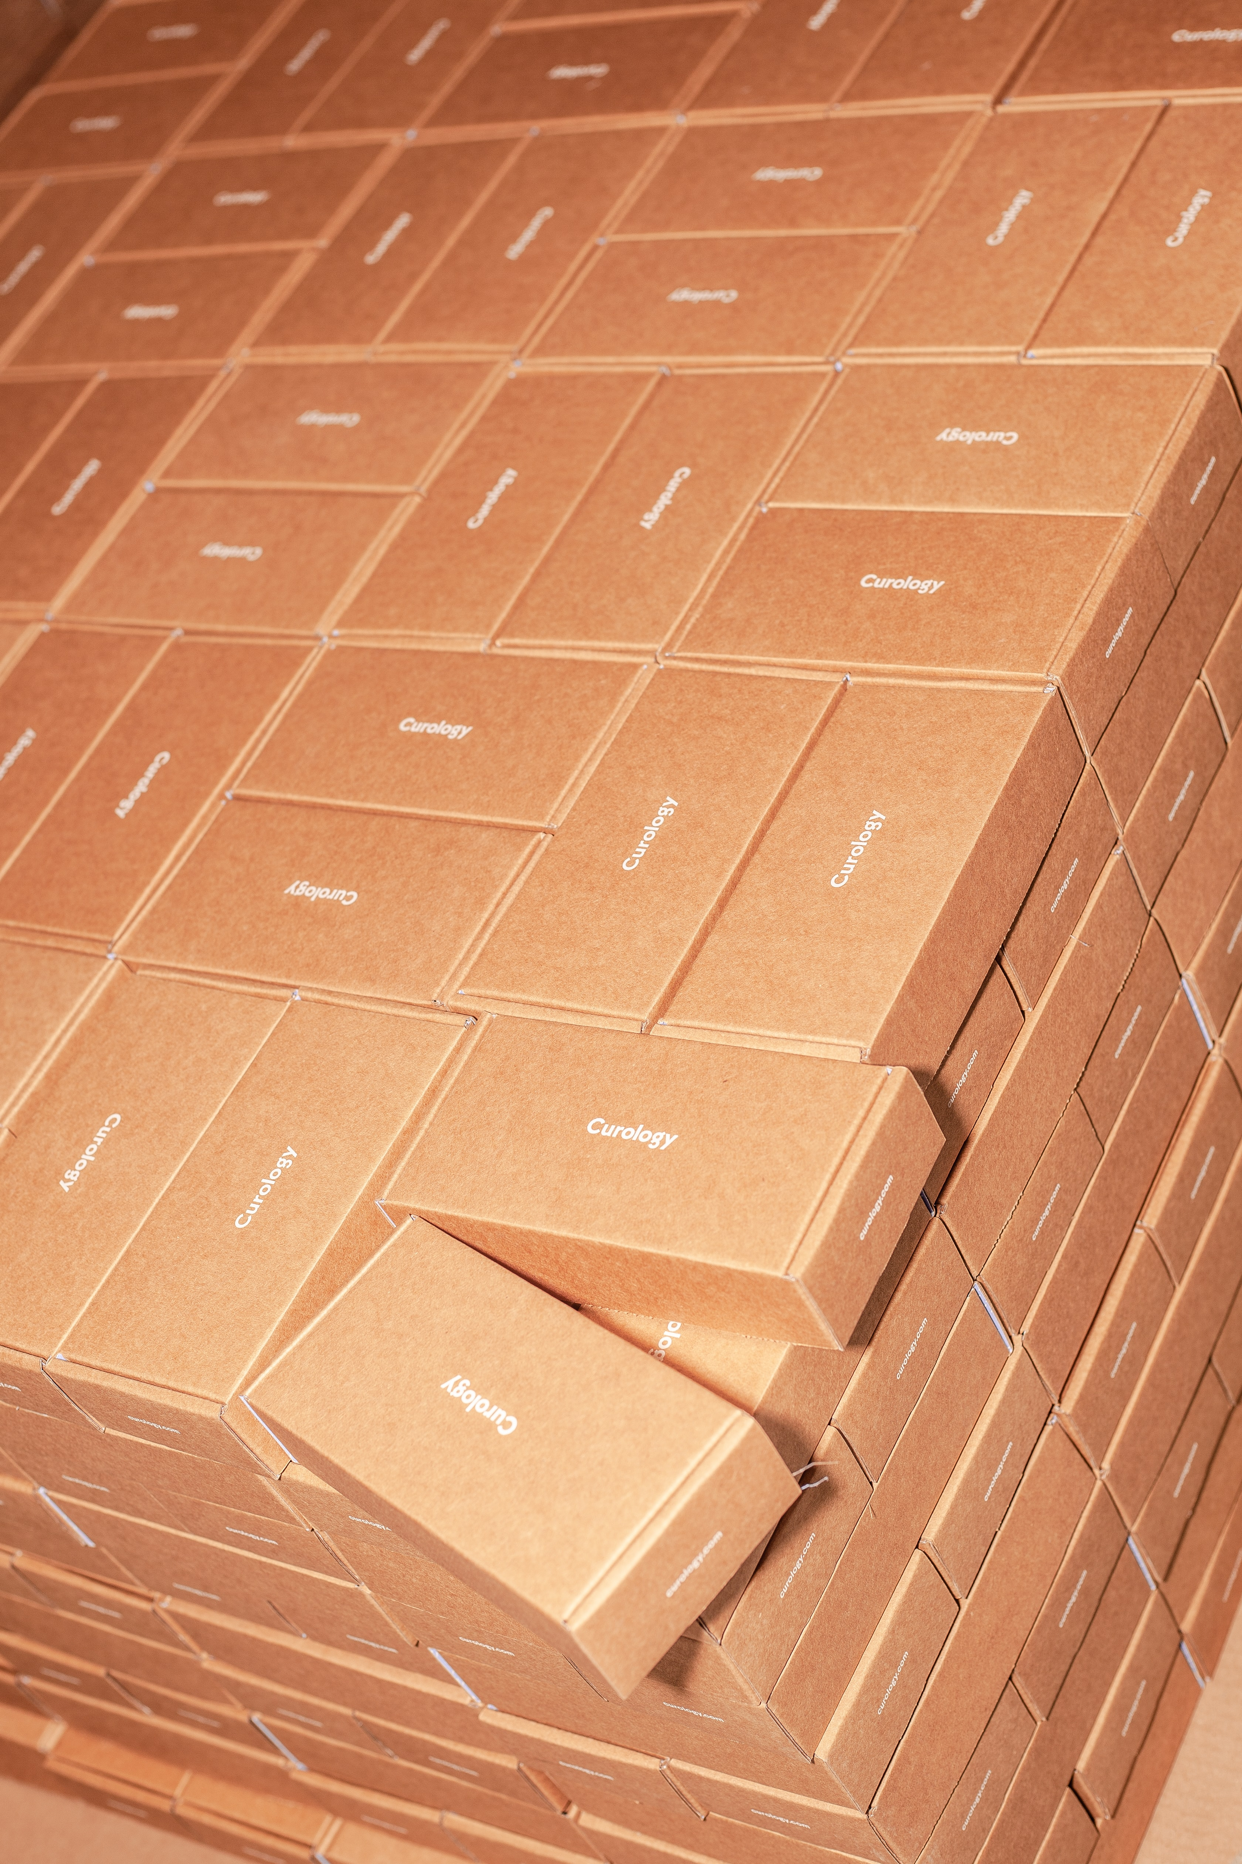
Measuring your efforts
Understand your break points from your suppliers and measure the effectiveness of your efforts.
At what quantity will you receive a bulk discount?
How many times were your discount codes used? Were they effective?
Were you able to generate product reviews or other social proof?

Slide 30
Resources

Slide 31
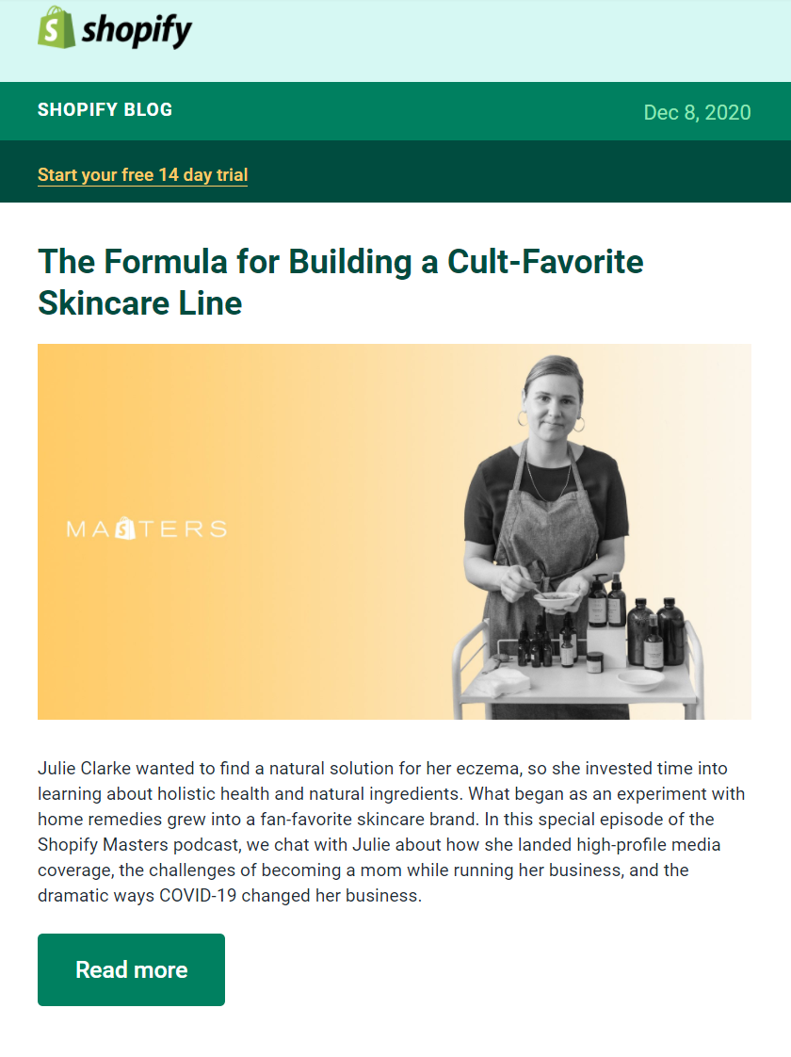
Where to go when you get stuck
You don’t need to know everything, having a support team is critical
Have you checked the Shopify Documentation?
Subscribe to the Shopify blog; it’s an amazing source for current trends and resources
Understand the risks of owning a business in your region.
You can find small business resources and programs from your local Small Business Enterprise Centre
Check out sprintpoint.ca for more free tools

Slide 32
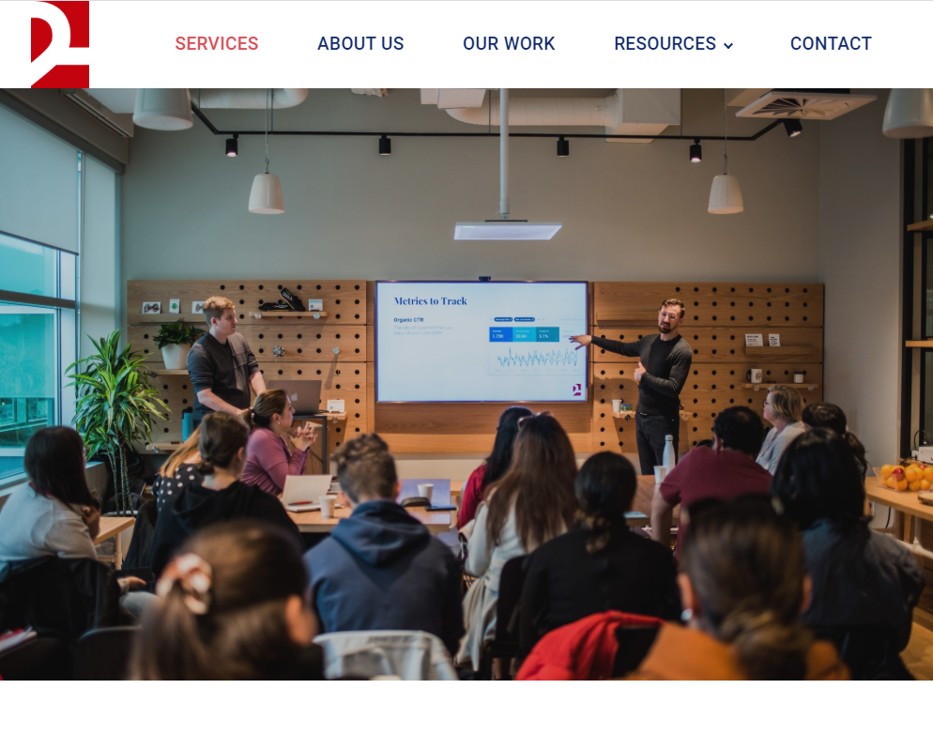
Questions?
How do I get the slides?
Subscribe to our newsletter at www.2h.media
How do we connect?
Follow 2H Media on LinkedIn
Specific Questions?
Give us a call
P: 519-835-3009
E: hello@2h.media

