Slide 1
Google My Business
Advanced
LAST UPDATED | JULY 16, 2021
DISOVER THE MOST POWERFUL FREE ONLINE TOOL FOR SMALL BUSINESSES.

Slide 2
Ecommerce
Web Development
Branding
People First Marketing
Email Marketing
Film & Photography
Education
Using transparency and communication to build business relationships.
Crowdfunding
Digital Marketing
P: 519-835-3009
E: hello@2h.media

Slide 3
What You’ll Learn
How to manage users
Adding Products
Adding Services
Posts
Reviews
Starting verification
Q & A

Slide 4
01
GMB Home

Slide 5
Log In And Let’s Start
www.google.com/business

Slide 6
Homepage
Navigate to the User Tab

Slide 7
02
GMB Users

Slide 10
03
GMB Services

Slide 11
Adding Services
Navigate to the Services Tab

Slide 12
Service Categories
CATEGORIES ALLOW YOU TO GROUP SIMILAR SERVICES
Industry
Department
Service type (Branding, Financial Services, Education )

Slide 13
Adding Services
YOU NEED THE FOLLOWING
Service name
Service price
Description

Slide 14
Adding Services
A COMPLETE SERVICE LISTING
As you add or subtract services from your offerings, make sure to update your collections

Slide 15
04
GMB Products

Slide 16
Adding Products
Navigate to the Products Tab

Slide 17
Product Categories
CATEGORIES ALLOW YOU TO GROUP SIMILAR PRODUCTS
Categorize by brand name
Style
Product type (Shoes, Kitchen Supplies, Food)
Size

Slide 18
Adding Products
YOU NEED THE FOLLOWING
A product image
Product price
Description
A complete CTA with a link*
*Multiple CTA options are available

Slide 19
Adding Products
A complete product listing
As you add or subtract products from your offerings, make sure to update your collections

Slide 20
05
GMB Posts

Slide 21
Posts
Navigate to the Posts Tab

Slide 22
What Are Posts?
POSTS ALLOW YOU TO BROADCAST INFORMATION TO USERS ON A VARIETY OF TOPICS.
Events
News
Offers (sales)
Product information
Sharing company updates
COVID-19 update

Slide 23
Best Post Practices?

Slide 24
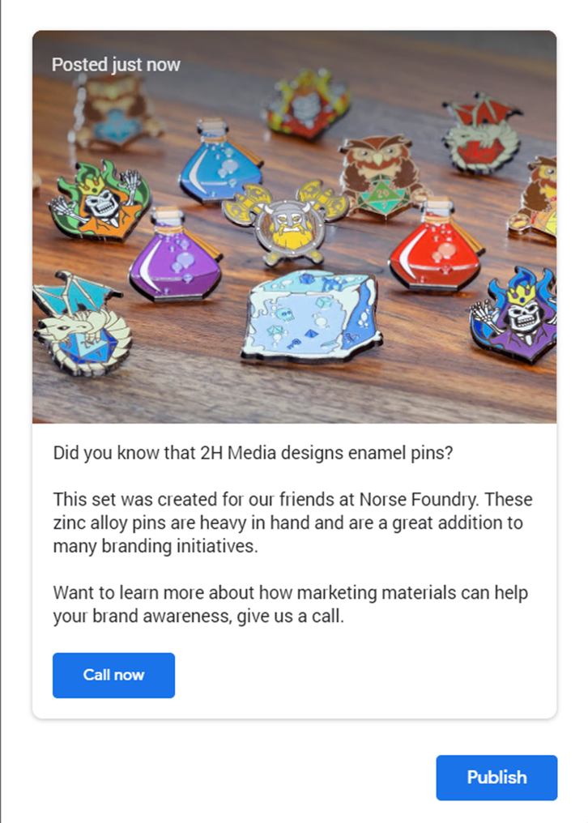
Build A Post
YOU NEED THE FOLLOWING
Picture
Description
Complete CTA*
*Multiple options are available

Slide 25
Posts
Posts are displayed at the bottom of your GMB business listing

Slide 26
06
GMB Offers

Slide 27
What Is An Offer?
Offers apply to overall marketing initiatives; they usually contain the following:
Dates
Conditions
Condensed descriptions

Slide 28
07
GMB Events & News

Slide 29
What Is An Event?
A TIME SPECIFIC OFFER
Dates
Conditions
Condensed descriptions
Great for physical locations and time sensitive material

Slide 30
Have News To Share?
GREAT FOR OFFERING ADDITIONAL INFORMATION
Changes to your business
Changes in related industries
Excellent for sharing information
Should be less sales focused

Slide 31
COVID-19 Posts
RECOMMENDATIONS
Should be updated as frequently as needed
Webpages or online appointment bookings should be available
Keep the messaging simple and short

Slide 32
Competitor Posts
Google keeps an eye on your competition for you
Great for inspiration

Slide 33
08
GMB Reviews

Slide 34
Reviews
Navigate to the Reviews Tab

Slide 35
Managing Reviews
Once you have verified

Slide 36
Getting Reviews
Navigate to the Home Tab
Click share review form
Note: You can personalize your review link by updating your Profile Short Name on the Info Tab.

Slide 37
08
GMB Verify

Slide 38
Verification
Your account must be verified prior to it being accessible by the public.

Slide 39
Verification
If you haven’t added an address you must enter this information for Google.
This information will not be public

Slide 40
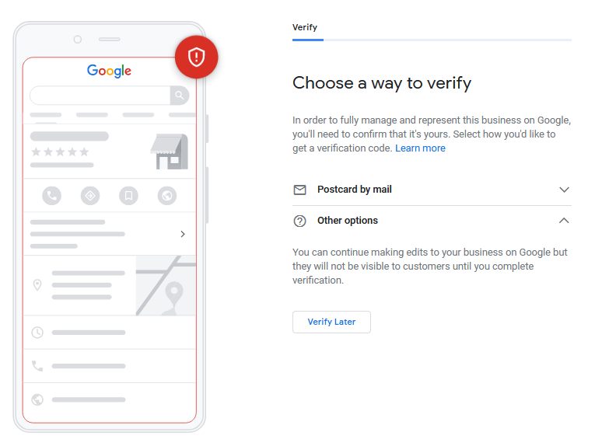
Choose A Way To Verify

Slide 41
Google will Snail Mail you a post card.
Notes:
Post 1 or 2 photos per week
Make sure the photos are properly tagged and the file name is optimized
Consider getting Google 360 photos to have a virtual tour of your business
Have at least 1 post per month, and as many Covid-19 posts as needed
Keep your products and/or services up to date with your website or other digital properties

Slide 42
Enter Your Verification Code

Slide 43
Enter Your Verification Code

Slide 44
Now What?
Notes:
Post 1 or 2 photos per week
Make sure the photos are properly tagged and the file name is optimized
Consider getting Google 360 photos to have a virtual tour of your business
Have at least 1 post per month, and as many Covid-19 posts as needed
Keep your products and/or services up to date with your website or other digital properties

Slide 45
Questions?
How do I get the slides?
Visit https://2h.media. The slides are on the workshop page.
How do we connect?
Follow 2H Media on LinkedIn.
Specific questions?
Give us a call.
P: 519-835-3009
E: hello@2h.media

