Slide 1
Last Updated | July 12, 2021
Beginner
Product Packaging
LEARN WHERE TO START AND WHAT TO PREPARE FOR

Slide 2
People First Marketing
Ecommerce
Web Development
Branding
Email Marketing
Film & Photography
Education
Crowdfunding
Digital Advertising
Using transparency and communication to build business relationships.
Aron Murch | Co-Owner, CIO
Worked in marketing since 2005
Joined 2H Media in January, 2020
Designed full packaging lines in toys and games, b2b wholesale, and grocery
519-835-3009
hello@2h.media

Slide 3
What you’ll learn
Packaging Requirements
Order of Operations
Packaging Timeline
Manufacturing Basics
Regional Packaging
Q&A

Slide 4
Packaging Requirements
COMPANY, RETAILER, CONSUMER
Design With Purpose
Most graphic designers are not manufacturing experts, retail experts, shipping experts, or lawyers.
As a business owner, you will be responsible for ensuring that your product packaging meets the needs of all stakeholders including your own requirements, retailer requirements, and consumer requirements.
FUNCTIONAL PACKAGING
Checks all legal boxes
Protects its contents
Is inexpensive to ship
Promotes your brand
Fits on standard shelves
Stands out on shelves
Creates an experience
Is reusable or collectable

Slide 5
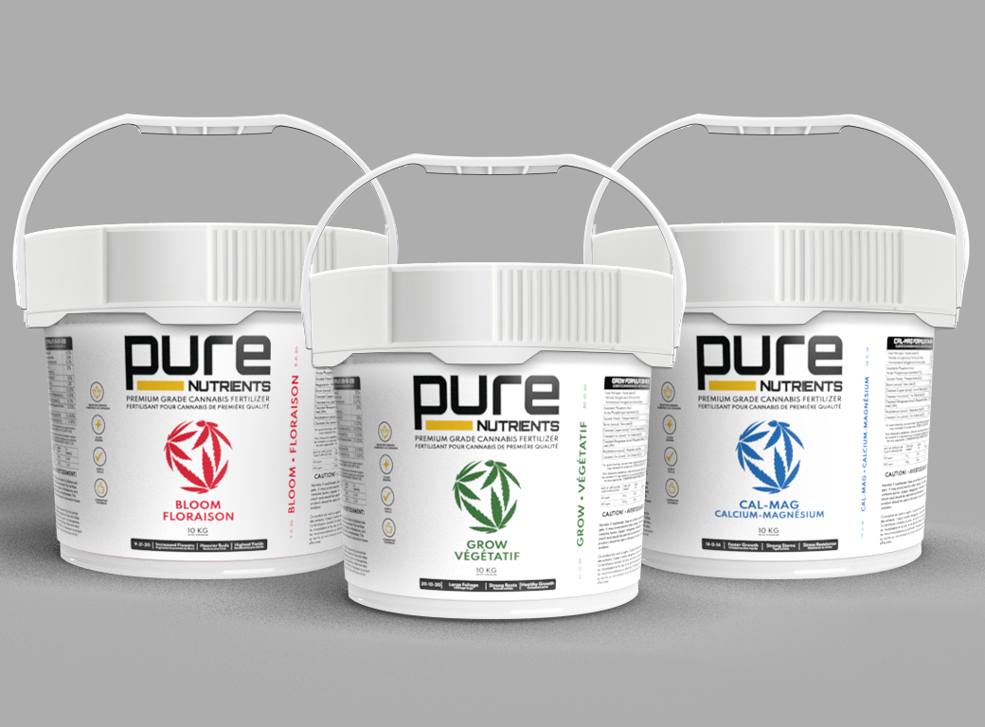
Your Requirements
Pure Nutrients, 2021
Determine needs vs Wants
Meeting all legal requirements and protecting the product are needs.
Minimizing shipping costs is an important want. Foil printing is probably a less important want.

Slide 6
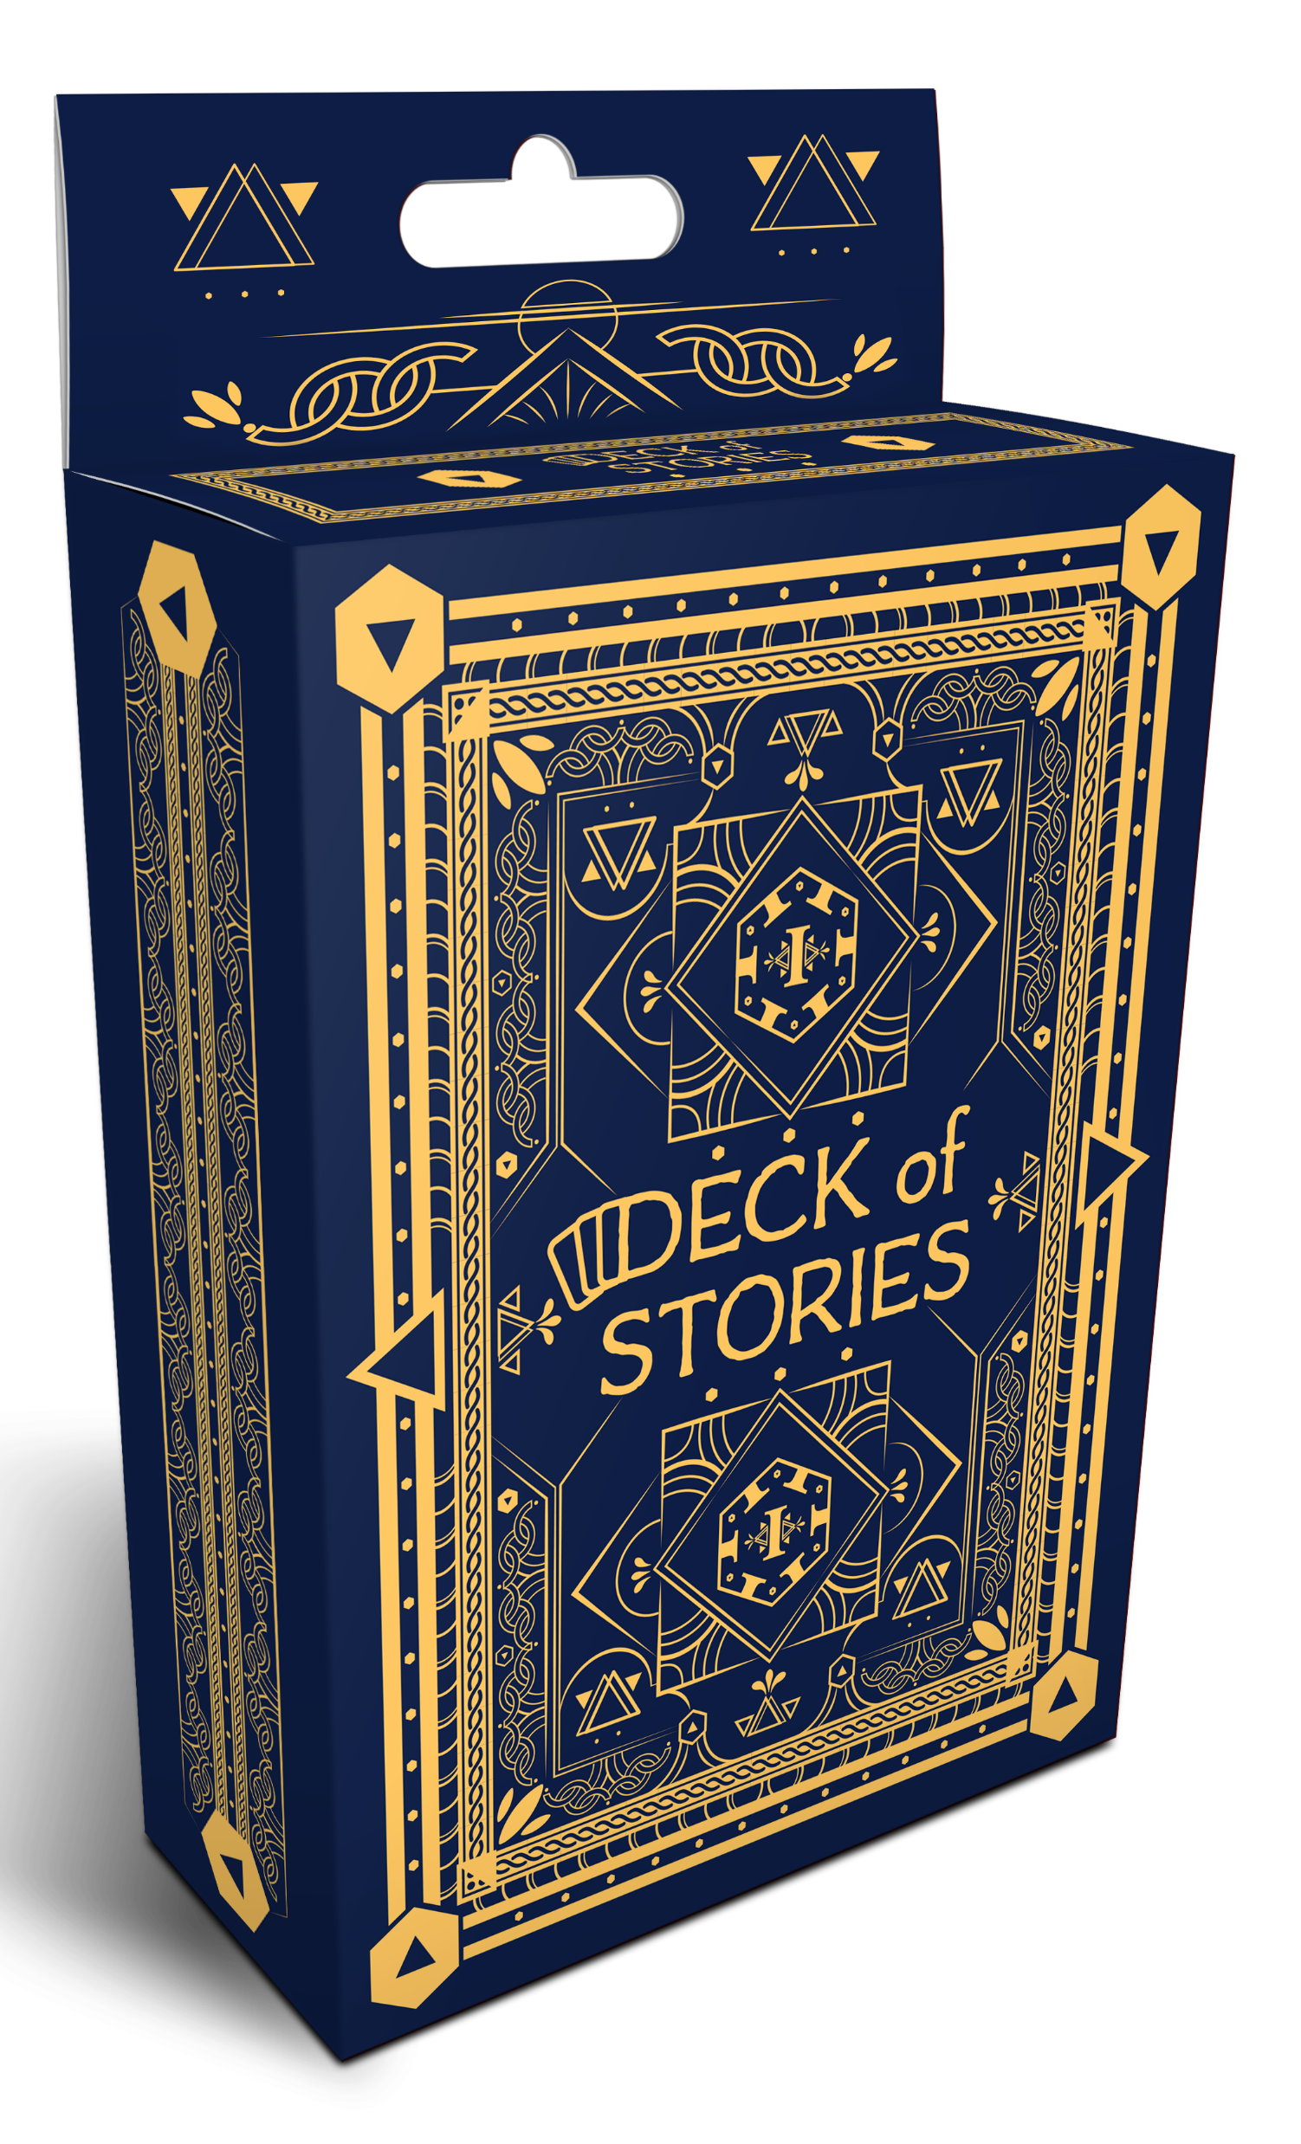
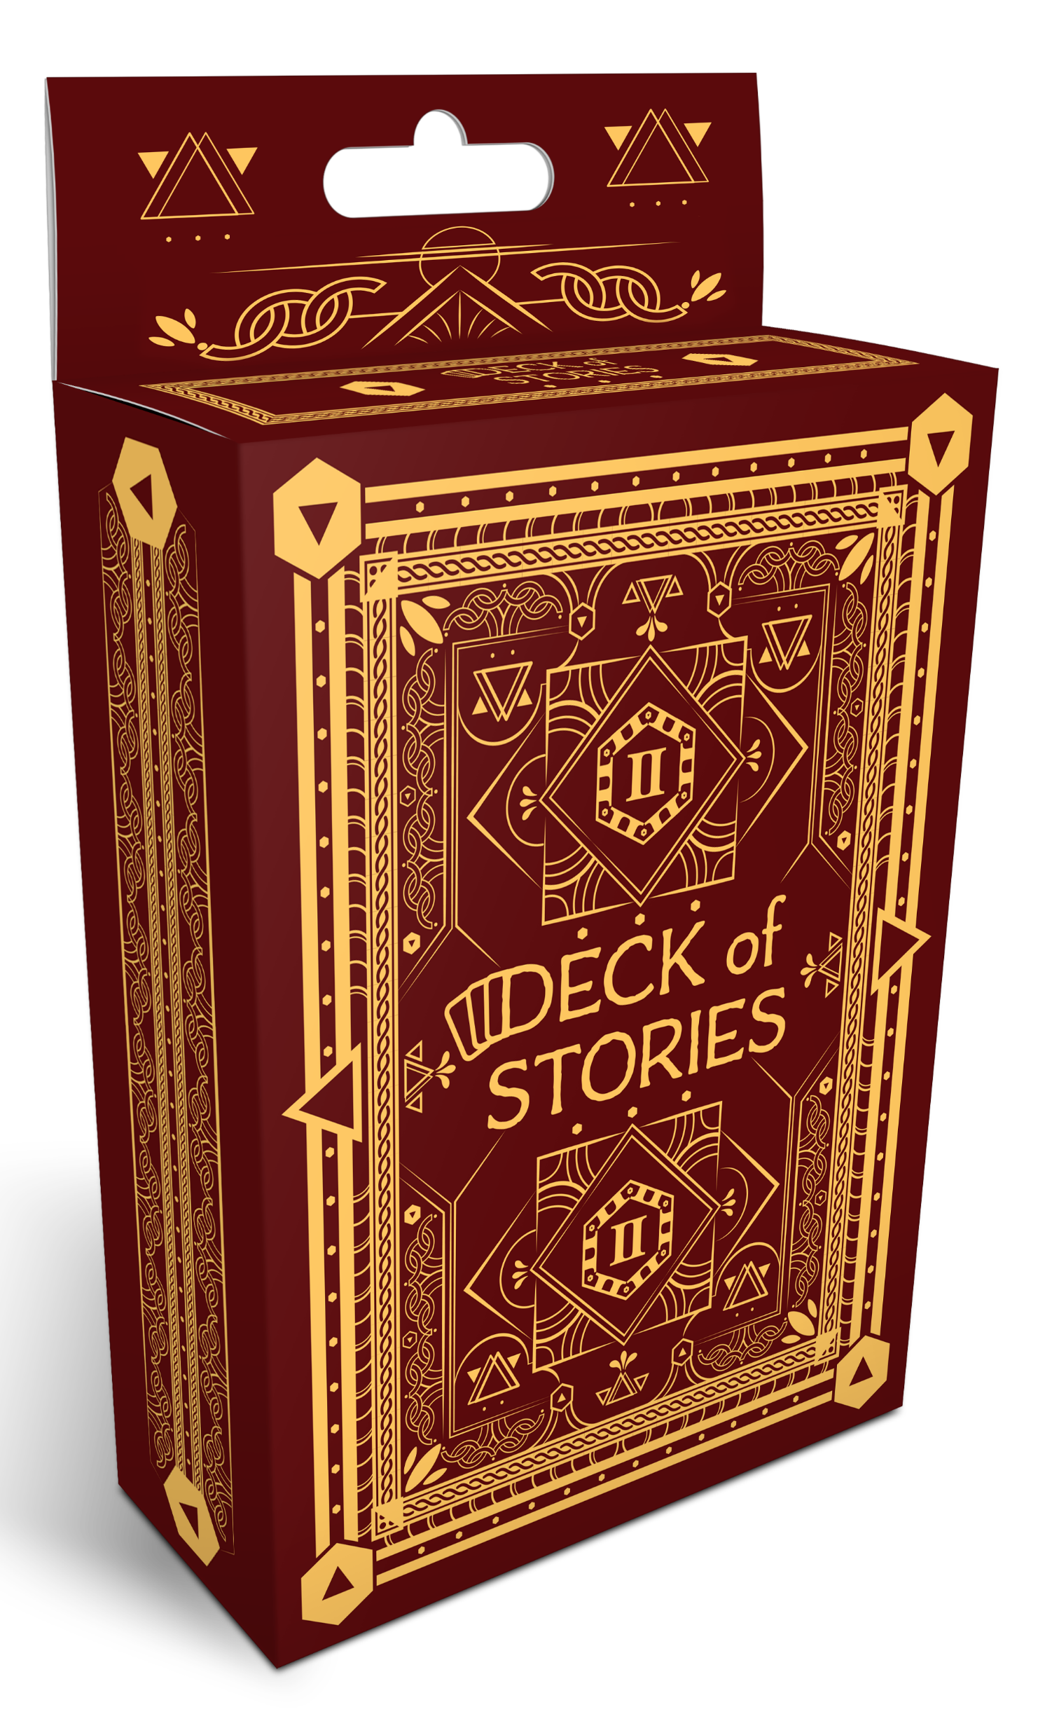
Retail Requirements
Deck of Stories, 2020
Secure Preferred Shelf Space
Retailers are running their own businesses.
Your products will be competing for space with everything they stock.
Give your products an advantage by planning to meet retailer needs.

Slide 7
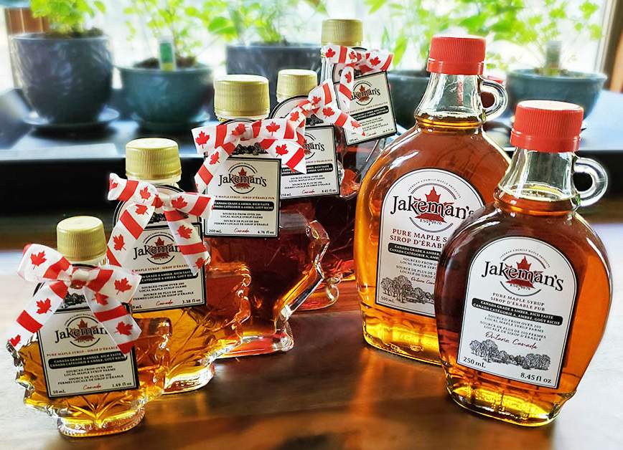
User Requirements
Jakeman’s Maple Products, 2020
Make an Impression
Consumer needs are evolving. Build brand equity by providing your consumers with a product that creates an experience.

Slide 8
Order of Operations
One step at a time
Plan
Determine legal requirements
Write a list of needs
Determine a budget
Secure manufacturing quotes and minimums
Design
Provide a list of requirements
Secure design quotes
Select a designer
Connect the designer with the manufacturer
Each designer will have their own process
Manufacture
Complete required revisions
Review digital proofs
Review white samples
Review physical proofs

Slide 9
Packaging Timeline
Plan early, Refine often
Plan
The more you put in, the better the results.
Manufacture
Take the time to get it done right.
3 MONTHS +
2-12 WEEKS
2-12 WEEKS
2-12 WEEKS
Design
Budget in time for revisions and meetings.
Ship
Local is a lot faster than international.

Slide 10
Manufacturing Basics
Where to manufacture and What to Ask
Local Manufacturing
Can be expensive
Great for small runs
Faster delivery
Inexpensive shipping
Often less complicated
Typically more reliable in specialty cases
Foreign Manufacturing
Prices vary by country
Best for large runs (5,000+)
Slow delivery
Expensive shipping
Can be complicated
Quality varies by country
Service can be excellent
Important qUESTIONS
What is your MOQ?
Can you provide quotes for A, B, and C quantities?
Do you provide physical proofs?
What are your shipping terms?

Slide 11
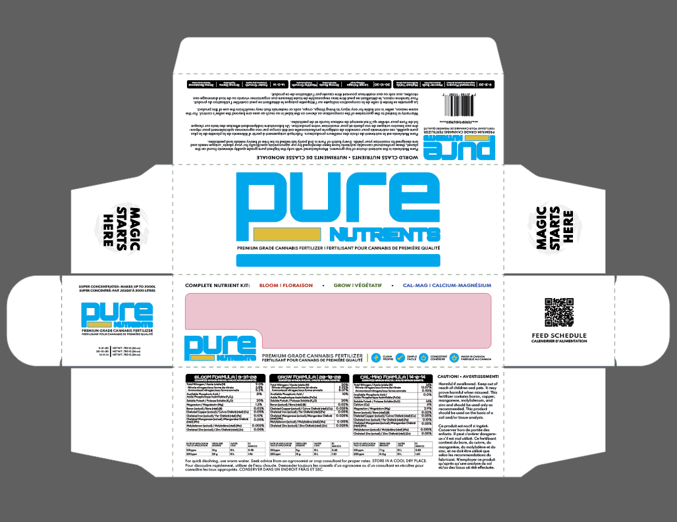
Premium Finishes
Pure Nutriends, 2021
Prepare to Print 20,000+
Spot UV (Glossy Sections)
Foil Printing (Shiny Sections)
Embossing (Raised Sections)
Letterpress (Imprinted Text)
Premium Materials (Cotton, Hemp, Wood, Metal, etc.)

Slide 12
Regional Packaging
Emballage Régional
Labelling Requirements
You are responsible for all requirements so do your own research
Consult a lawyer or a government body
The government has a lot of helpful information
Food Packaging
Certain industries have very strict requirements
The government has a comprehensive checklist
The government will provide nutrition label templates for free
Plan to perform a nutrition test in an independent lab
Common Missteps
Using the Canadian Maple Leaf
Relying on free translation software
Shrinking bar codes, nutrition labels, disclaimers
Poor colour contrast
Missing CE Marking and safety markings

Slide 13
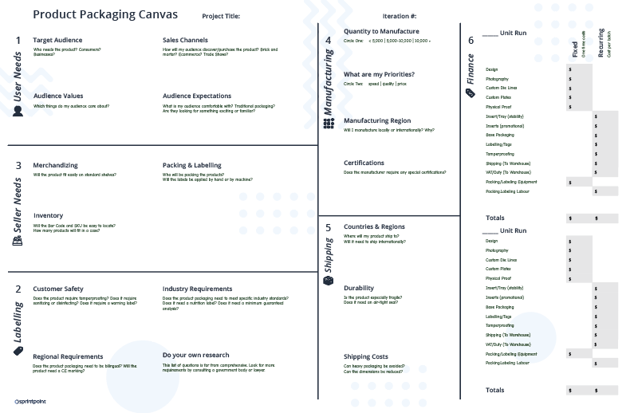
Questions?
How do I get the slides?
Visit https://2h.media. The slides are on the workshop page.
How do we connect?
Follow 2H Media on LinkedIn.
Specific questions?
Give us a call.
P: 519-835-3009
E: hello@2h.media
Plan your product line with a Product Packaging Canvas, available free on sprintpoint.ca.

